Slide 1
Open Source Software Engineering
SE ZG587
Kumar Manish
14 Oct, 2023

Slide 2
Session 11 : Contributing to Open Source Software Projects

Slide 3
Agenda
Contributing to Open Source Software Projects
  Contribution models and roles in OSS
  Familiarizing with the open source software ecosystem
  Starting your own Open Source Project
  Best practices in running/ managing OSS project
Version control

Slide 4
Recap
Lifecycle and methodologies in Open Source Software
Open Source Software Development Model
  Comparing OSS development methodologies with traditional methodologies – Waterfall, and Agile
  Unique characteristics of the Open Source Software Development Process Model

Slide 5
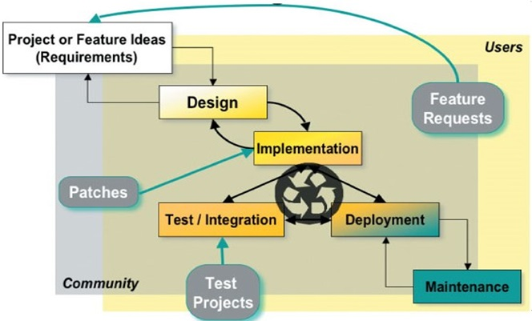
Open Source Software Development Model

Slide 6
Unique Characteristic of OSS Development model
Release early, release often
Peer Review
Small, incremental changes
Highly secure code
Continuous quality improvement
Test projects
End user involvement

Slide 7
Contribution Roles
There are Number of roles that exit in any open source project.
Depending on your intertest, you may choose to contribute as any one or many of them .
Project Leader / Main Developer : A leader acts like the CEO of the company and is responsible for all major decisions. Smaller projects may have several developers in the lead role, similar to board of directors in an organisation
  You may acquire the role of a project leader , when you start your own project or open source an existing projects seeking contributions.
Programmer : Programmers are mainly responsible for implementation of features and fixing.

Slide 8
Contribution Roles
Designer : UI/UX or web designers or art work designers
Document writer : project documentation has gained importance since , for the not so skilled end users , installing and using open source software is difficult. Detailed documentation helps novice users as well as beginner contribution in understand the project scope and code.
Translator : A large number of open source projects welcome contributions who are willing to translate the project manuals in their native language.
Active user : They form the base of the pyramid l use the software ; provide feedbacks and customised the product.

Slide 9
How to contribute other than code to Open source software projects ?
Create , edit or translate the documentation of existing Open source projects
  Contribute Tutorials on how to sue the project
  Create newsletter
Plan events
  Help in organizing workshops , meetings , conferences
Refine or contribute designs
  Refine project navigation/ menus
  Create a style guide for visual layout
Contribute in organising project
  Restructure project layout
  Track issues, Link duplicate issues , suggest new issue labels
Contribution to the forums :
  Answer question about the project
  Help moderate the discussion boards or conversation channels

Slide 10
Familiarizing yourself with an Open source Project

Slide 11
Familiarization yourself with an open source project
Pre-requisite before starting to contribute :
Learn a Programming Language
  Get started with any language of your choice
  Do not emphasize on learning a new language for contributing to open source
  Go with what you already know
Familiarize yourself with version control system ( VCS)
  There are many version control system such as Git, CVS and SVN
  Git is the most popular and most widely used version control system in the industry
Search an Open source project (Active) in the chosen Language
  Navigate GitHub repository of the selected project
  Read the documentation
  Go through the license information
  Check if the project has a CLA that need to be signed
  Join the IRC ( internet Relay chat ) channel ( discord/ slack)

Slide 12
Familiarizing yourself with an Open source
Start with going through beginner-friendly issues search for first –timer issues as mentioned above
  Try to work on as many issue as you can either across projects or for a single project
  You can also create issues after running the application locally
To search for easy or beginner level issues :
Navigate to the repo of the project
Different VCS follow different conventions for making issues
Search for issue which are marked as follows :
  Good First issue is : issue is : open label : good first issue
  Easy issue is : issue is : open label : easy
  First Timer issue is : issue is : open label : first –timers-only

Slide 13
Familiarizing your self with an Open Source projects
Understand the anatomy of project
  Author, owner , Maintainers . Contributors , event Organizers
Read through these documents :
  LICENSE every open source project consists of a file that describe the license used by it , if the project does not have a license , it is not open source
  README : It explains the usefulness of the project and how it can be used . Might also contains instructions about how a new comer can start contributing
  CONTRUBUTING : explains the type of contributors that are needed and how the entire contributions process works . This document might NOT be present in may projects, yet its presence indicates that it is a welcoming projects, inviting contributors.

Slide 14
Familiarizing yourself with an open source project
CODE_OF _CONDUCT : Explains the basic rules for participants “behaviour and helps in facilitating the projects welcoming environment
Other documentation : The project might contain some additional documentations , such as tutorials, walkthrough or governance policies etc.
Familiarize yourself with the communication tools used in the project:
Issue tracker : used to discuss issues related to the project
Pull request : used to discus and review changes that are in progress
Discussions forums or mailing List : channels used by some projects for conversational topics
Synchronous chat channel : These are used for casual conversation, collaboration and quick exchange of messages.

Slide 15
Starting your own Open Source Project

Slide 16
Starting your own Open Source Project
Prerequisite for a stating a new OSS project
Develop a new idea
Evaluate the concept or idea
Study and analyse if something is already available ?
  If yes, improve your idea
  If no, move ahead
Evaluate if you posses the required skills and expertise ?
If no , work with the community to gain the same and later, re-evaluate .
If yes , start your own project .....

Slide 17
Starting your own Open Source Project
Here are some ways in which the work on an open source project can start :
An individual conceptualise the idea for a project and announces the same in public
An individual starts the implementation on the project code base (limited feature but working ) , release it to the public as the first version of the open source project
The source code of a mature project is release to the project
A well established open source project is forked by an interested individual or outside organisation with intent to extend it

Slide 18
Starting your own Open Source Project
Process model for development of open source software projects
Feasibility study phase – Investigate what exactly exits - if a similar or same project exist - refine or improve on your idea
Stage 1 : Initiation phase : in case a new project is started
  Project identification
  Searching for development Team
  Solution Identification and development of a work plan
Stage 2 : Execution Phase : In case an existing project is adopted
  Code Development and Testing
  Code Review and commit
  Documentation
Stage 3 : Release Phase : Release code to the public

Slide 19
Starting your own Open Source Project
Develop the eco system for the project
Establish a goal for your project
Create a plan , roadmap or strategy to accomplish your goal
  Choose an exiting , popular license
  Build an official website for your project
Find community members
  Raise awareness
  Post your project details to relevant forums
  Set up communications channels for your project
  Create separate mailing lists , project specific discussions boards etc
  Request contributors to further promote your project - efforts multiply

Slide 20
Starting your own Open Source Project
Develop the eco –system for the project
Choose and set up other technical requirements of the project , which includes software development tools for :
  Version control,
  Issue tracking,
  Automating build process,
  Designing ,
  Coding an testing.
Arrange for necessary funds , if required.

Slide 21
Version control

Slide 22
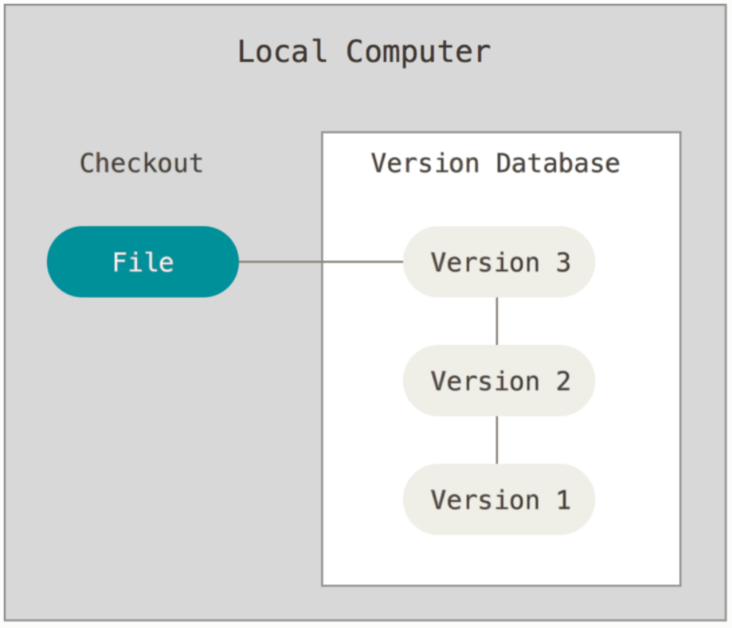
Local version control system
Version control is a system that records changes to a file or set of files over time so that you can recall specific versions later.

Slide 23
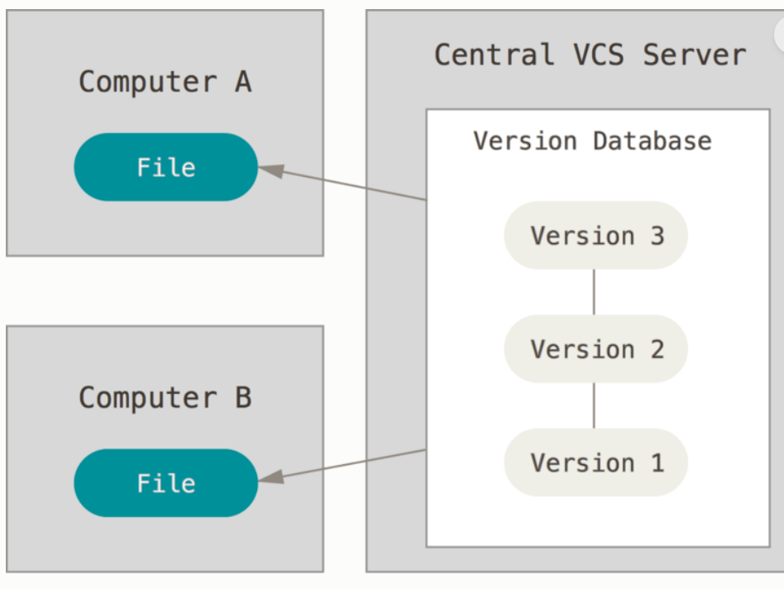
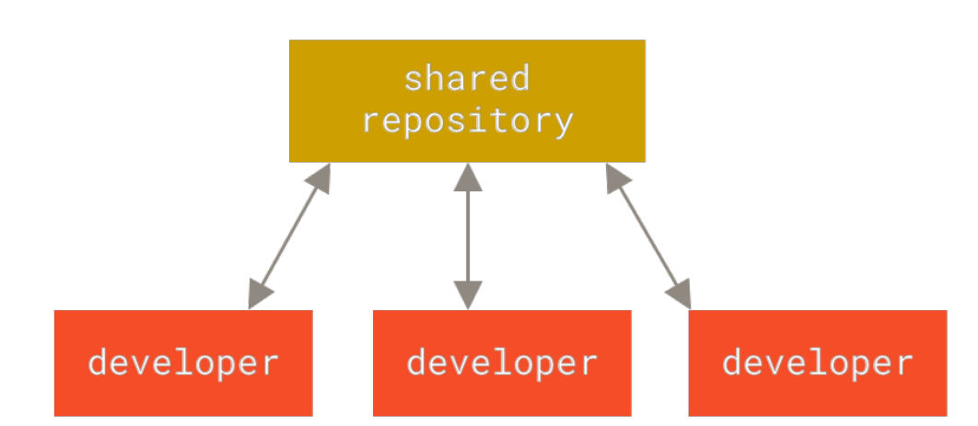
Centralised version control system

Slide 24
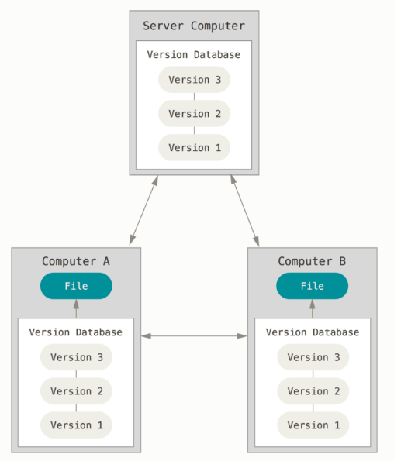
Distributed version control system

Slide 25
Git and GitHub

Slide 26
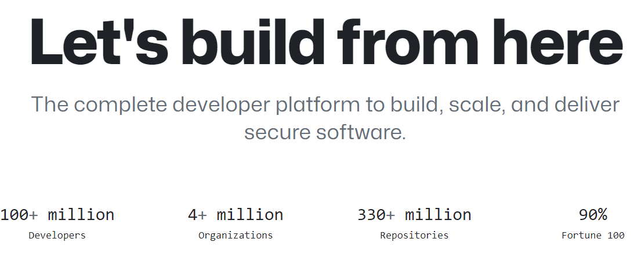
Git, GitHub and GitHub Enterprise Cloud
GitHub is a code hosting platform for collaboration and version control.
GitHub lets you (and others) work together on projects.

Slide 27
Development goals of Git
Speed,
Simplified design
Completely distributed
Strong support for branching (non linear development), involving thousands of parallel branches
Able to handle large projects like the Linux kernel efficiently; in terms of speed and data size.

Slide 28
History of Git
The famous open source project – Linux kernel – used a proprietary Distributed Version Control System (DVCS) called Bitkeeper.
In 2005, the relationship between the company that developed Bitkeeper and the Linux community broke down
The Bitkeeper company NO longer offered the tool free of charge
The Linux community decide to develop their own DVCS for supporting large open source projects

Slide 29
What is Git ?
An Open-source distributed version control system (DVCS)
Primarily used by developers - for the task of writing code.
It has a command line interface – GIT CLI
It helps to keep track of modifications to your files that are stored in a project repository (“Repo”)
Allows a developer to work on this Repo either independently or with a team of developers working collaboratively on the same project
It provides a useful environment for Team Work; everyone can work independently on the files and manage their changes later
Additionally, it also maintains a permanent record of who made which changes

Slide 30
What is GitHub ?
GitHub is a website that allows developers to upload their Git repositories online – on the Internet
GitHub comes with a rich visual interface for navigating the project repositories
It not only helps in providing a backup of the files, but also make collaboration over repositories much more easier and effective.
Additionally, it enables other people also to navigate through your repos and hence helps is easier collaboration
It is not mandatory to use Git, while you are using GitHub, however , it is quite common to use GitHub while using Git

Slide 31
GitHub CLI
GitHub CLI is an open source tool for using GitHub from your computer's command line. When you're working from the command line, you can use the GitHub CLI to save time and avoid switching context.
GitHub CLI includes GitHub features such as:
View, create, clone, and fork repositories
Create, close, edit, and view issues and pull requests
Review, diff, and merge pull requests
Run, view, and list workflows
Create, list, view, and delete releases
Create, edit, list, view, and delete gits

Slide 32
GitHub Desktop
GitHub Desktop is an open source tool that enables you to be more productive.
GitHub Desktop encourages you and your team to collaborate using best practices with Git and GitHub.
Just a few of the many things you can do with GitHub Desktop are:
Add changes to your commit interactively
Quickly add co-authors to your commit
Checkout branches with pull requests and view CI statuses
Compare changed images

Slide 33
GitHub Enterprise
GitHub provides two types of Enterprise products:
GitHub Enterprise Cloud
GitHub Enterprise Server
The main difference between the products is that GitHub Enterprise Cloud is hosted by GitHub, while GitHub Enterprise Server is self-hosted.

Slide 34
GitHub Mobile
GitHub Mobile gives you a way to do high-impact work on GitHub Enterprise Cloud quickly and from anywhere.
GitHub Mobile is a safe and secure way to access your GitHub Enterprise Cloud data through a trusted, first-party client application.
With GitHub Mobile you can:
Manage, triage, and clear notifications
Read, review, and collaborate on issues and pull requests
Edit files in pull requests
Search for, browse, and interact with users, repositories, and organizations
Receive a push notification when someone mentions your username
Secure your GitHub.com account with two-factor authentication
Verify your sign in attempts on unrecognized devices

Slide 35
In summary
Git is responsible for everything GitHub-related that happens locally on your computer.
You can also install GitHub CLI to use GitHub from the command line.
If you want to work with Git locally, but do not want to use the command line, you can download and install the GitHub Desktop client.
If you do not need to work with files locally, GitHub Enterprise Cloud lets you complete many Git-related actions directly in the browser

